Slide 1

Tic-Tac-Q
Amaia
Ane
Iván
Mikel
Rubén

Slide 2


Slide 4
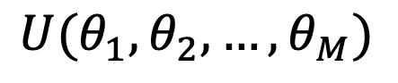
Quantum Born Machine
$$U(θ_{1}, θ_{2}, …, θ_{M})$$

Slide 5
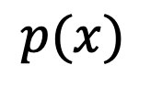
Quantum Born Machine
$$p(x)$$
$$U(θ_{1}, θ_{2}, …, θ_{M})$$

Slide 6
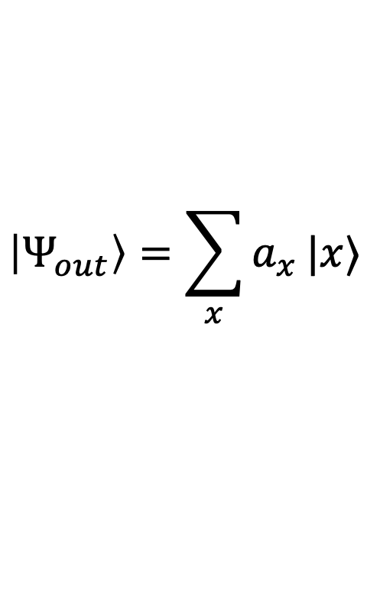
Quantum Born Machine
$$p(x)$$
$$\left|Ψ_{out}\right\rangle =\sum_{x}{a_{x}}|x⟩$$
$$U(θ_{1}, θ_{2}, …, θ_{M})$$

Slide 7
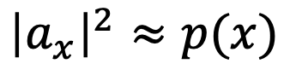
Quantum Born Machine
$$p(x)$$
$${\left|a_{x}\right|}^{2}≈p(x)$$
$$\left|Ψ_{out}\right\rangle =\sum_{x}{a_{x}}|x⟩$$
$$U(θ_{1}, θ_{2}, …, θ_{M})$$

Slide 8
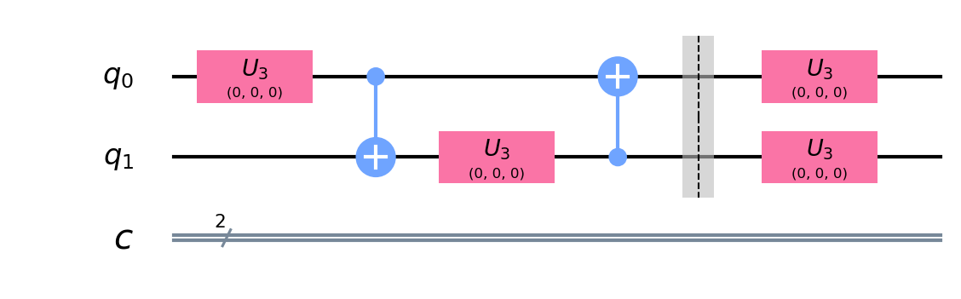

Slide 9
X | P(x)
|00> | 0.5
|01> | 0.2
|10> | 0.2
|11> | 0.1

Slide 10



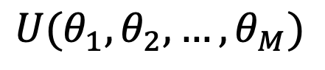

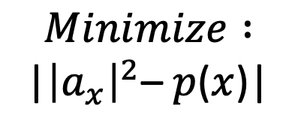
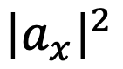
$$Trial$$
$$Final$$
$$(θ_{1}, θ_{2}, …, θ_{M})$$
$$(θ_{1}, θ_{2}, …, θ_{M})$$
$$Minimize :$$
|${\left|a_{x}\right|}^{2}$– $p$($x$)|
$${\left|a_{x}\right|}^{2}$$
$$U(θ_{1}, θ_{2}, …, θ_{M})$$

Slide 11
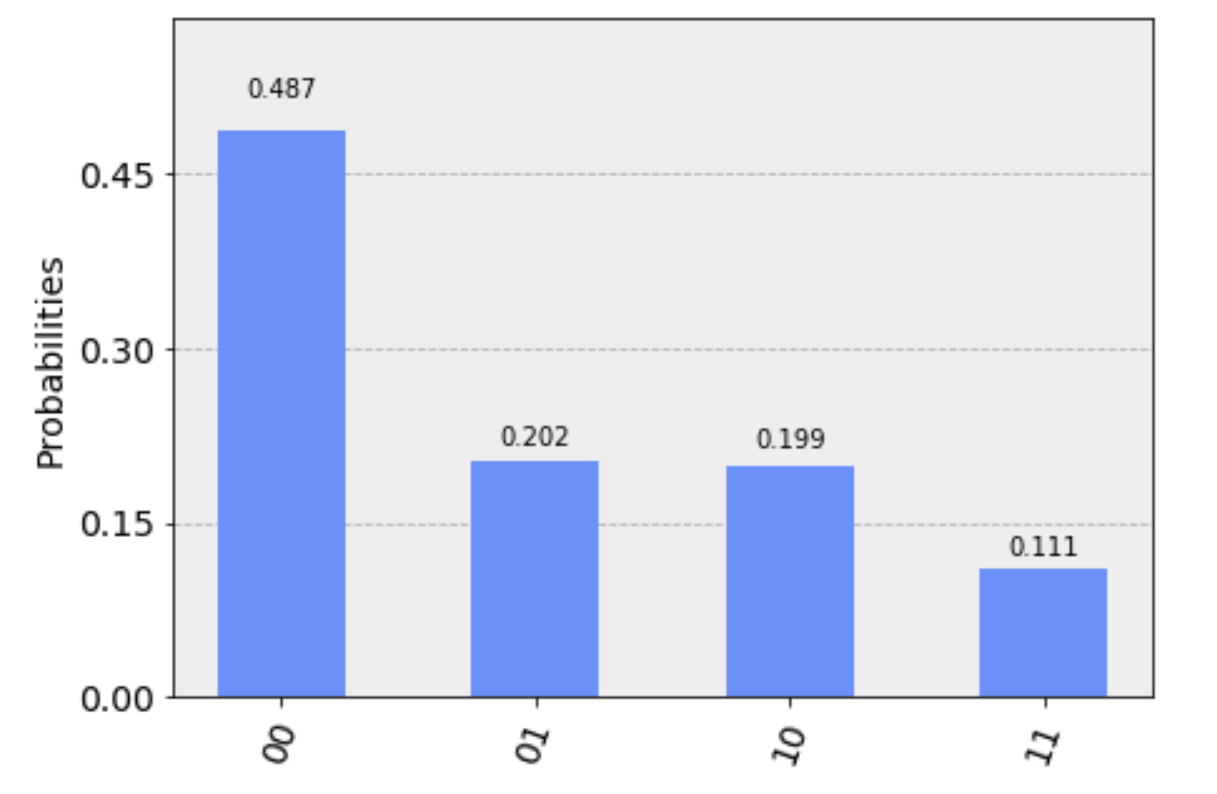
Comparison obtained probability distribution
X | P(x)
|00> | 0.5
|01> | 0.2
|10> | 0.2
|11> | 0.1
0.487
0.202
0.199
0.111

Slide 12
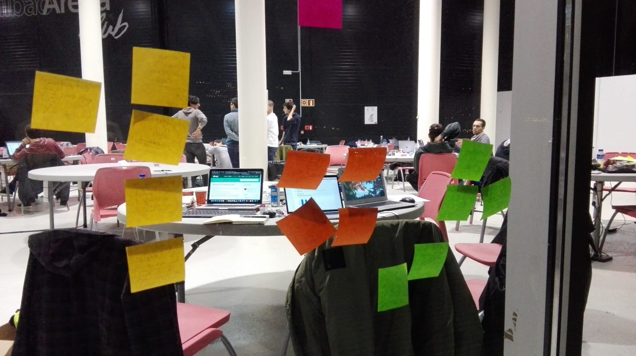

Slide 13

QBM

Slide 14
Obtained results
Wins
Wins
Failures
Failures

Slide 15
Parameters increasing effectiveness of the tuning
Parameter
max_iter
max_error
step
X_0

Slide 16
Future linework
Modify parameters for better results
Add blank state to the cells

Slide 17
Tic-Tac-Q
Amaia
Ane
Iván
Mikel
Rubén
Thank you!
Mila esker!

